Slide 1
Basic concepts of Probability
Md. Ismail Hossain Riday

Slide 2
Probability
Probability is the likeliness/chance of occurring any event(s).
Consider tossing a coin.
What is the chance of it landing heads up?
What is the chance of it landing tails up?

Slide 3
Experiment
A specific action, or
A process, or
A phenomenon that leads to observable outcomes

Slide 4
Experiment
An experiment refers to a specific action, process, or phenomenon that leads to observable outcomes.
For example,
Measuring distance from Dhaka to Chattogram
Tossing a fair coin

Slide 5
Experiment
An experiment refers to a specific action, process, or phenomenon that leads to observable outcomes.
For example,
Measuring distance from Dhaka to Chattogram
Tossing a fair coin

Slide 6
Experiment
An experiment refers to a specific action, process, or phenomenon that leads to observable outcomes.
For example,
Measuring distance from Dhaka to Chattogram
Tossing a fair coin

Slide 7
Types of Experiment
Two types of experiment-
Deterministic: Whose outcome is predictable in advance
Probabilistic/Random: Whose outcome is not predictable

Slide 8
Some examples
Is tossing a coin a random experiment or deterministic experiment?
Ans: Tossing a coin is an experiment. There are two possible outcomes (head or tail). These outcomes are unpredictable before the coin is tossed. Therefore, this is a random experiment.

Slide 9
Some examples
Is drawing a card from well shuffled deck of cards a random experiment or deterministic experiment?
Ans: Drawing a card from a well-shuffled deck of cards is a random experiment. The randomness arises from the uncertainty of which card will be drawn, even though the deck is well-shuffled. The outcome (the specific card drawn) is not predictable beforehand, making it a random event.

Slide 10
Some examples
Is multiplying 4 and 8 on a calculator a random experiment or deterministic experiment?
Ans: Multiplying 4 and 8 on a calculator is a deterministic experiment. In a deterministic experiment, the outcome is certain and predictable based on the given inputs and the rules of the operation. In this case, multiplying 4 and 8 will always result in the same answer: 32. There is no randomness or uncertainty involved in this calculation, making it a deterministic process.

Slide 11
Basic terms
Sample space:

Slide 12
Basic terms
The result of an experiment is known as outcomes
Outcome
Sample space
Head (H)
and
Tail (T)
All possible outcomes
Outcome

Slide 13
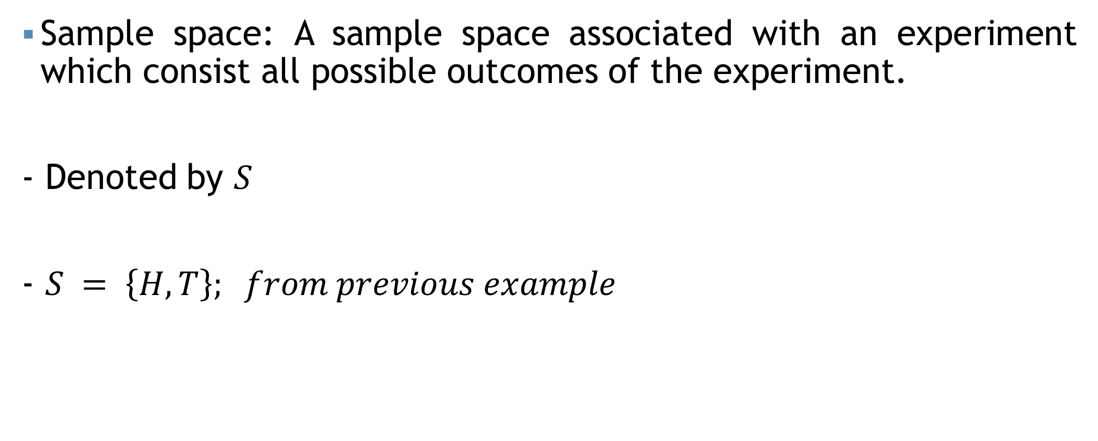
Basic terms
Sample space: A sample space associated with an experiment which consist all possible outcomes of the experiment.
- Denoted by $S$
- $S = \left\{H, T\right\}; from previous example$

Slide 14
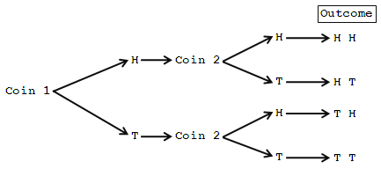
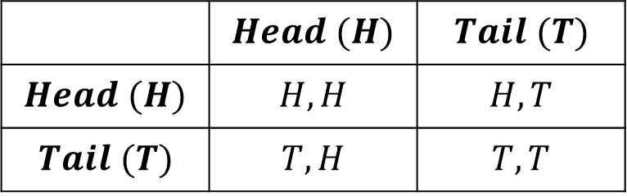
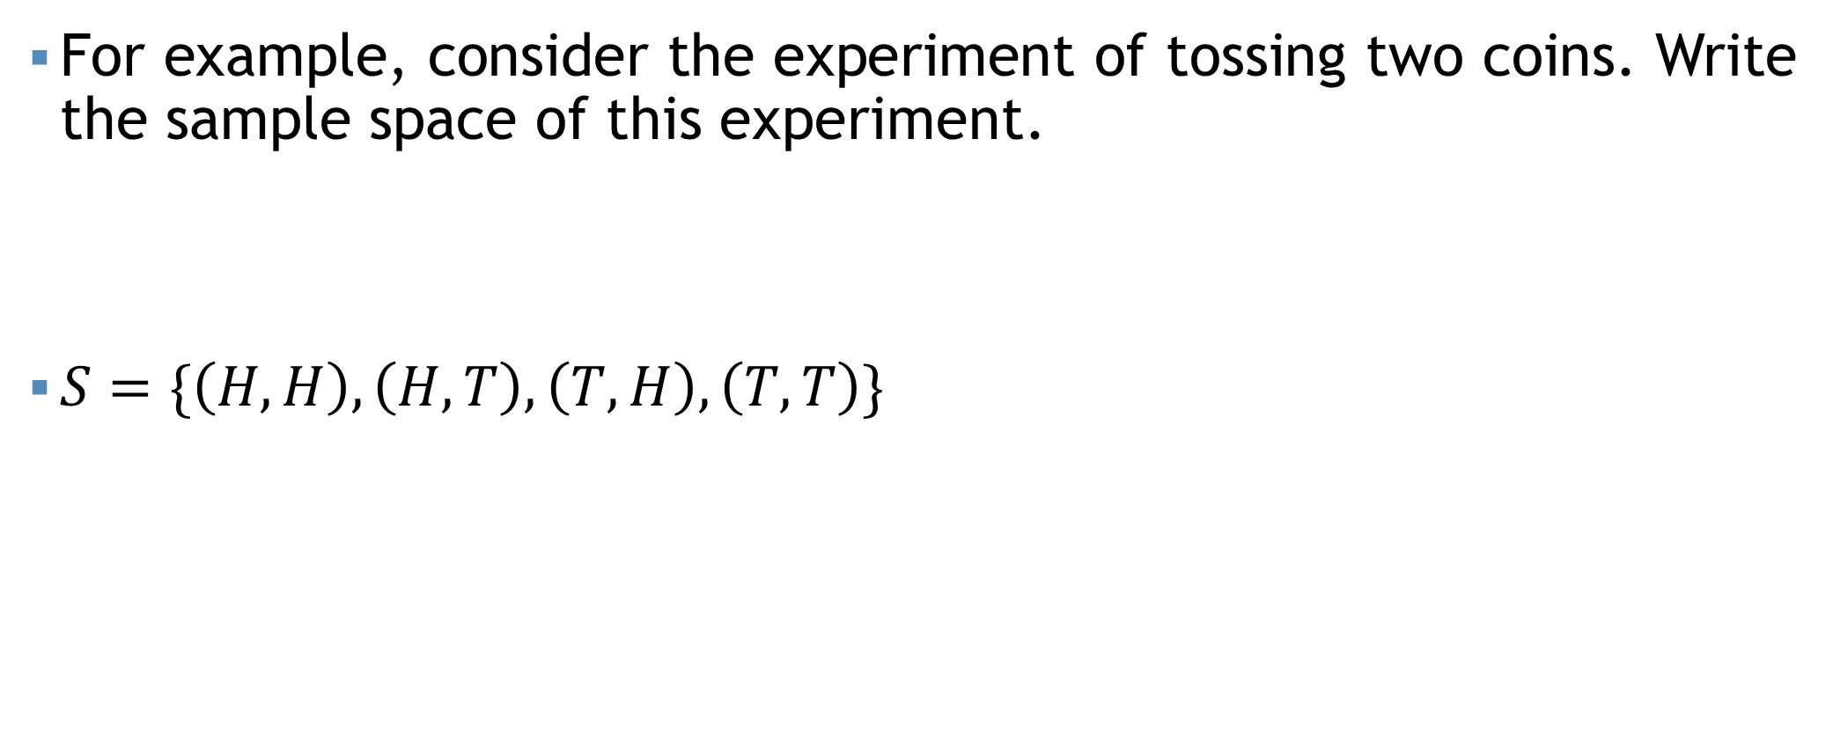
Basic terms
For example, consider the experiment of tossing two coins. Write the sample space of this experiment.
$S=\{\left(H,H\right),\left(H,T\right),\left(T,H\right),\left(T,T\right)\}$
 | $$Head (H)$$ | $$Tail (T)$$
$$Head (H)$$ | $$H,H$$ | $$H,T$$
$$Tail (T)$$ | $$T,H$$ | $$T,T$$

Slide 15
Basic terms
For example, consider the experiment of throwing two dices. Write the sample space of this experiment.
 | 1 | 2 | 3 | 4 | 5 | 6
1 | 1,1 | 1,2 | 1,3 | 1,4 | 1,5 | 1,6
2 | 2,1 | 2,2 | 2,3 | 2,4 | 2,5 | 2,6
3 | 3,1 | 3,2 | 3,3 | 3,4 | 3,5 | 3,6
4 | 4,1 | 4,2 | 4,3 | 4,4 | 4,5 | 4,6
5 | 5,1 | 5,2 | 5,3 | 5,4 | 5,5 | 5,6
6 | 6,1 | 6,2 | 6,3 | 6,4 | 6,5 | 6,6

Slide 16
Basic terms
Consider an experiment of tossing three coins simultaneously. Write down the sample space.
Write the sample space and tree diagram of toss a coin and rolling a dice simultaneously.
Total number of outcomes in a sample space for rolling a die until a 4 appears?
What is the sample space for selecting an even number between 1 and 10?
Infinity (Depends on when 4 appears)
S = {2,4,6,8,10}

Slide 17
Basic terms
Event:

Slide 18


Basic terms
Is this a random experiment?
Yes, sir!
Can you write the sample
space?
$$S=\left\{1,2,3,4,5,6\right\}$$
Split the odd number…
An Event
$$A=\left\{1,3,5\right\}$$

Slide 19
Basic terms
Event: Any subset of the sample space

Slide 20
Basic terms
Union of events $\left(A∪B\right)$
Union of events (𝐴∪𝐵)
Intersection of events $(A∩B)$
Intersection of events (A∩𝐵)
Complement of an event $\left(\overline{A} or A′\right)$
Complement of an event (𝐴 ̅ 𝑜𝑟 𝐴′)
Exclusive event
Exhaustive event
Equally likely event
Event: Any subset of the sample space
Different types of events:
Exclusive events: Two events are called mutually exclusive if both the events cannot occur simultaneously in a single trial. In other words, if one of those events occurs, the other event will not occur.
Exhaustive events: Exhaustive events are those, which includes all possible outcomes.
Equally likely events: The events of a random experiment are called equally likely if the chance of occurring those events are all equal.

Slide 21
Basic terms
A = The sum of the two dice is 4
B = The sum of the two dice is at most 6
C = Doublet
For example, consider the experiment of throwing two dices. Write the sample space of this experiment.
 | 1 | 2 | 3 | 4 | 5 | 6
1 | 1,1 | 1,2 | 1,3 | 1,4 | 1,5 | 1,6
2 | 2,1 | 2,2 | 2,3 | 2,4 | 2,5 | 2,6
3 | 3,1 | 3,2 | 3,3 | 3,4 | 3,5 | 3,6
4 | 4,1 | 4,2 | 4,3 | 4,4 | 4,5 | 4,6
5 | 5,1 | 5,2 | 5,3 | 5,4 | 5,5 | 5,6
6 | 6,1 | 6,2 | 6,3 | 6,4 | 6,5 | 6,6

Slide 22
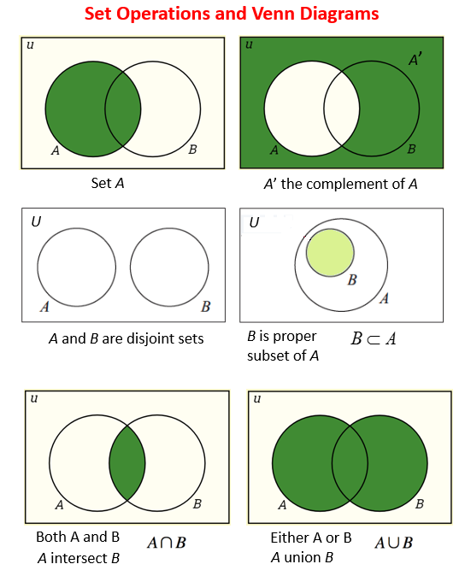

Basic terms
$$A∪\left(B∪C\right)=\left(A∪B\right)∪C$$
$$A∩\left(B∩C\right)=\left(A∩B\right)∩C$$
$$A∪\left(B∩C\right)=\left(A∪B\right)∩\left(A∪C\right)$$
$$A∩\left(B∪C\right)=\left(A∩B\right)∪\left(A∩C\right)$$
$$A∩\overline{B}=A−\overline{B}$$
$$\overline{\left(A∪B\right)}=\overline{A}∩\overline{B}$$

Slide 23
Approaches of assigning probability
At first, we identify the sample space S of the random experiment.
We then define our favorable event and assign probability to the event using one of the following 3 basic approaches-
Classical
Frequency
Subjective

Slide 24





Classical approach
$$P\left(Event\right)=\frac{Number of occurance/outcome in the event}{Total number of outcomes in the sample space}$$
Assumption-
Equally likely outcome
Mutually exclusive outcome
Mutually exhaustive outcome
$$P\left(A\right)=\frac{3}{6}$$
$$A=\left\{2, 4, 6\right\}$$
$$S=\left\{1, 2, 3, 4, 5, 6\right\}$$
$$P\left(B\right)=\frac{3}{6}$$
$$B=\left\{1, 3, 5\right\}$$

Slide 25
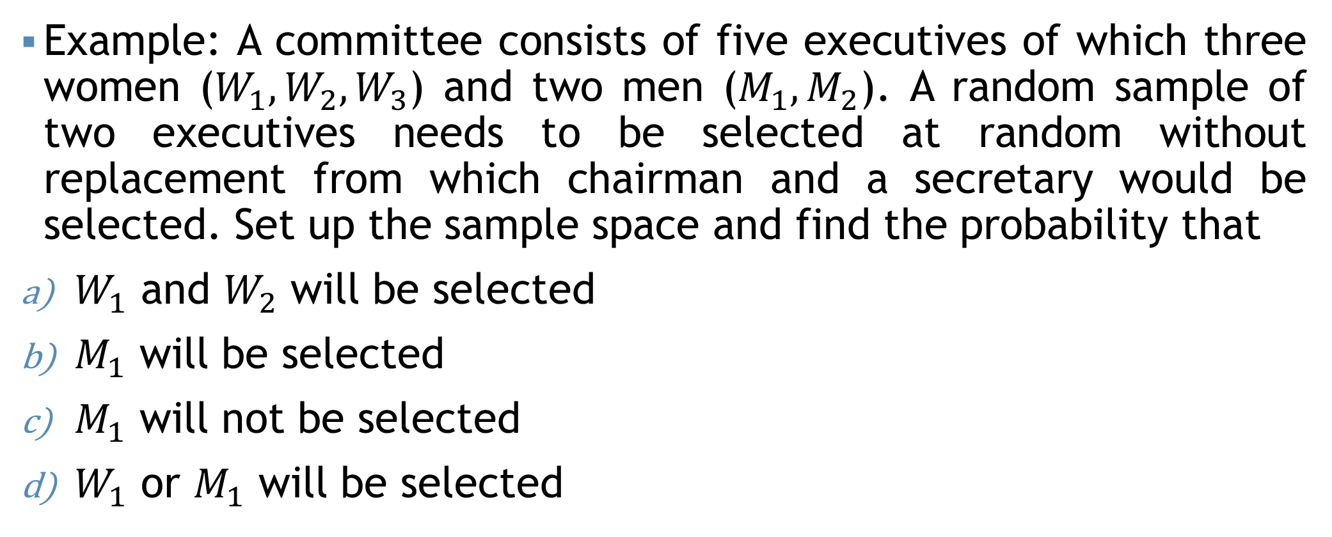
Classical approach
Example: A committee consists of five executives of which three women ($W_{1}, W_{2}, W_{3}$) and two men ($M_{1}, M_{2}$). A random sample of two executives needs to be selected at random without replacement from which chairman and a secretary would be selected. Set up the sample space and find the probability that
$W_{1}$ and $W_{2}$ will be selected
$M_{1}$ will be selected
$M_{1}$ will not be selected
$W_{1}$ or $M_{1}$ will be selected

Slide 26

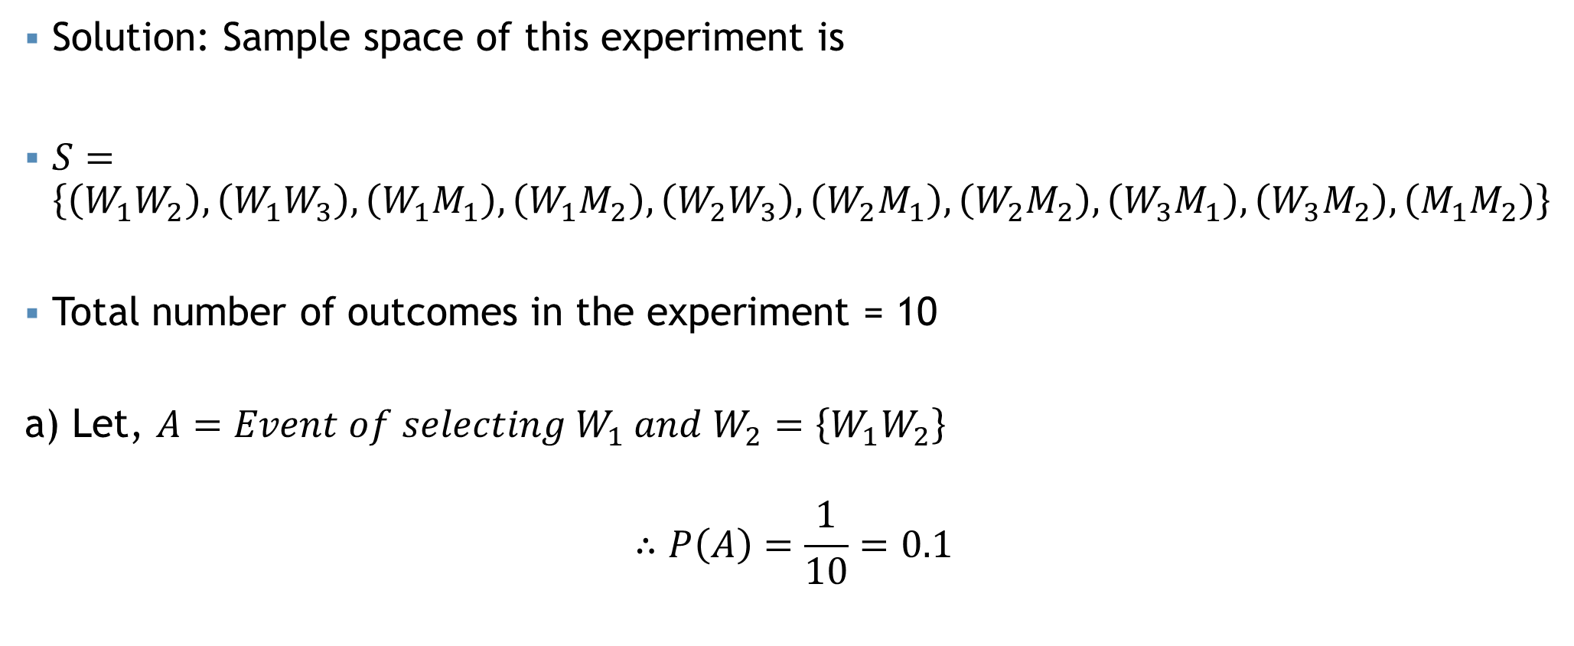
Classical approach
a) $W_{1}$ and $W_{2}$ will be selected
Solution: Sample space of this experiment is
$S=\left\{\left(W_{1}W_{2}\right),\left(W_{1}W_{3}\right),\left(W_{1}M_{1}\right),\left(W_{1}M_{2}\right),\left(W_{2}W_{3}\right),\left(W_{2}M_{1}\right),\left(W_{2}M_{2}\right),\left(W_{3}M_{1}\right),\left(W_{3}M_{2}\right),\left(M_{1}M_{2}\right)\right\}$
Total number of outcomes in the experiment = 10
a) Let, $A=Event of selecting W_{1} and W_{2}=\left\{W_{1}W_{2}\right\}$
$$∴P\left(A\right)=\frac{1}{10}=0.1$$

Slide 27

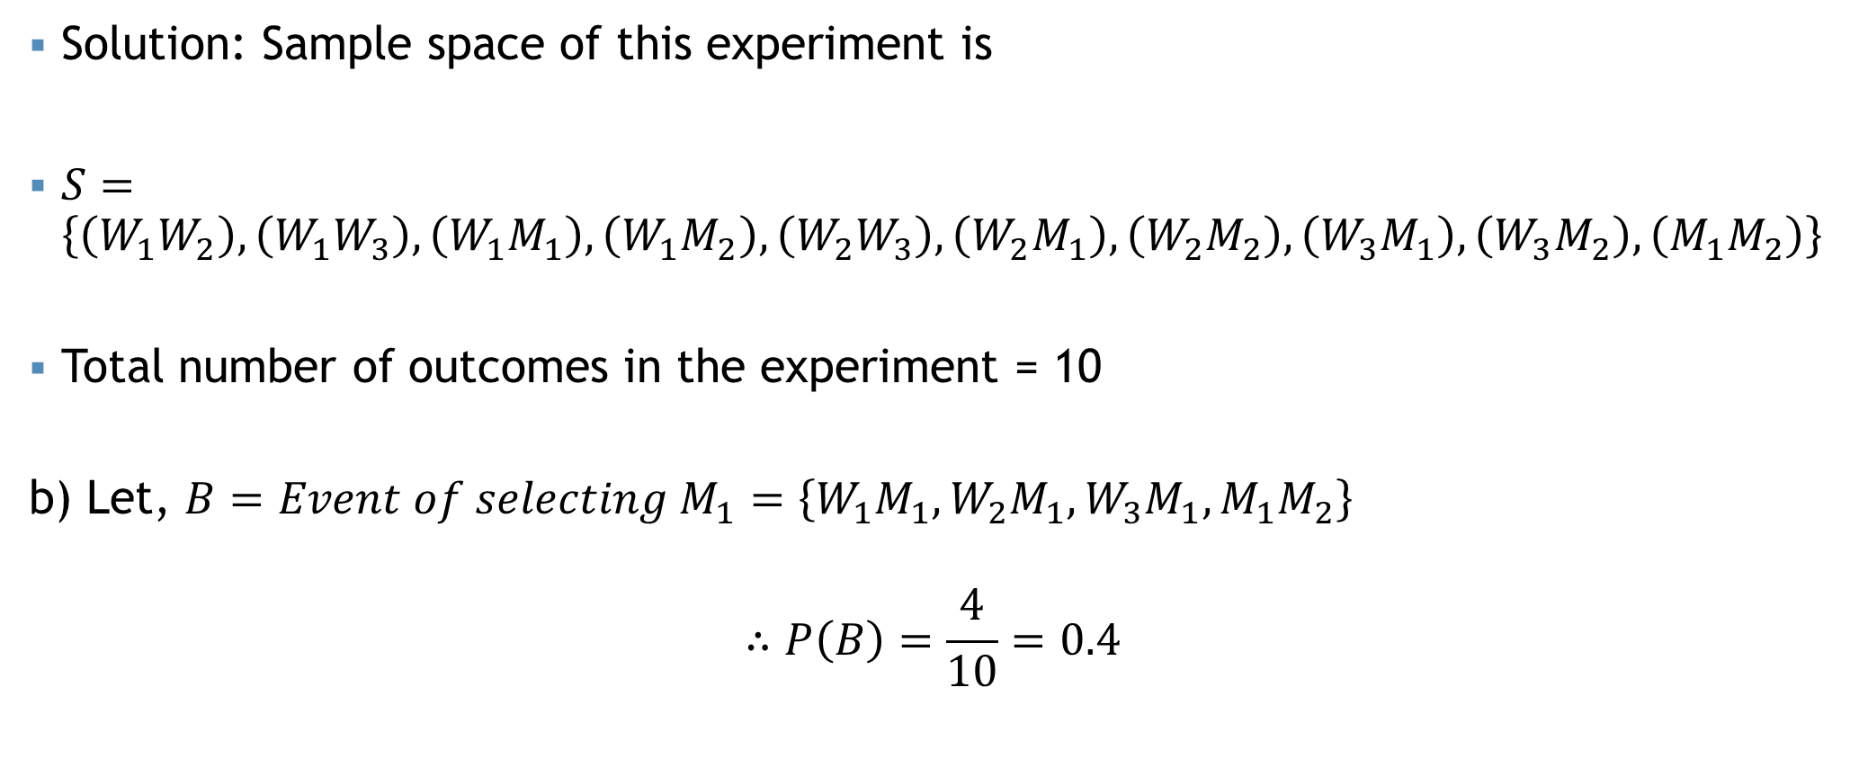
Classical approach
b) $M_{1}$ will be selected
Solution: Sample space of this experiment is
$S=\left\{\left(W_{1}W_{2}\right),\left(W_{1}W_{3}\right),\left(W_{1}M_{1}\right),\left(W_{1}M_{2}\right),\left(W_{2}W_{3}\right),\left(W_{2}M_{1}\right),\left(W_{2}M_{2}\right),\left(W_{3}M_{1}\right),\left(W_{3}M_{2}\right),\left(M_{1}M_{2}\right)\right\}$
Total number of outcomes in the experiment = 10
b) Let, $B=Event of selecting M_{1}=\left\{W_{1}M_{1},W_{2}M_{1},W_{3}M_{1},M_{1}M_{2}\right\}$
$$∴P\left(B\right)=\frac{4}{10}=0.4$$

Slide 28


Classical approach
c) $M_{1}$ will not be selected
Solution: Sample space of this experiment is
$S=\left\{\left(W_{1}W_{2}\right),\left(W_{1}W_{3}\right),\left(W_{1}M_{1}\right),\left(W_{1}M_{2}\right),\left(W_{2}W_{3}\right),\left(W_{2}M_{1}\right),\left(W_{2}M_{2}\right),\left(W_{3}M_{1}\right),\left(W_{3}M_{2}\right),\left(M_{1}M_{2}\right)\right\}$
Total number of outcomes in the experiment = 10
c) Let, $B=Event of selecting M_{1}=\left\{W_{1}M_{1},W_{2}M_{1},W_{3}M_{1},M_{1}M_{2}\right\}$
$$∴P\left(\overline{B}\right)=1−P\left(B\right)=1−\frac{4}{10}=0.6$$

Slide 29

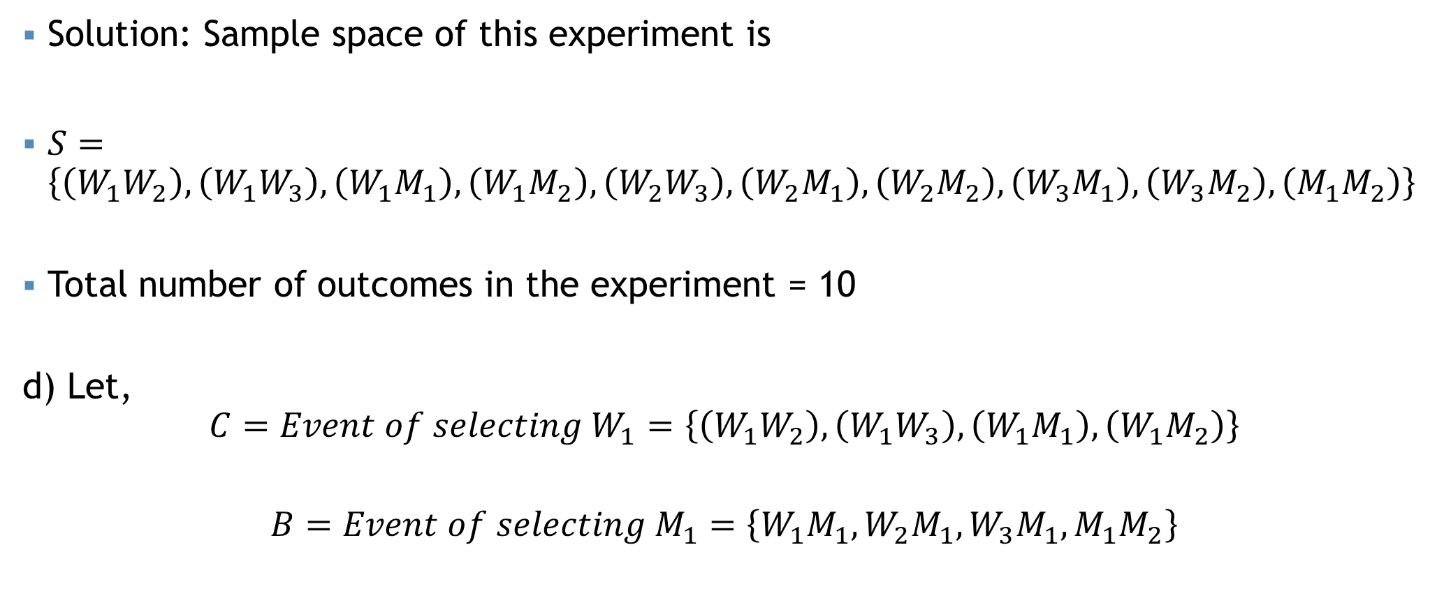
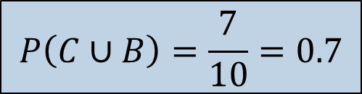
Classical approach
d) $W_{1} or M_{1}$ will be selected
Solution: Sample space of this experiment is
$S=\left\{\left(W_{1}W_{2}\right),\left(W_{1}W_{3}\right),\left(W_{1}M_{1}\right),\left(W_{1}M_{2}\right),\left(W_{2}W_{3}\right),\left(W_{2}M_{1}\right),\left(W_{2}M_{2}\right),\left(W_{3}M_{1}\right),\left(W_{3}M_{2}\right),\left(M_{1}M_{2}\right)\right\}$
Total number of outcomes in the experiment = 10
d) Let,
$$C=Event of selecting W_{1}=\left\{\left(W_{1}W_{2}\right),\left(W_{1}W_{3}\right),\left(W_{1}M_{1}\right),\left(W_{1}M_{2}\right)\right\}$$
$$B=Event of selecting M_{1}=\left\{W_{1}M_{1},W_{2}M_{1},W_{3}M_{1},M_{1}M_{2}\right\}$$
$$C or B=C∪B=\left\{\left(W_{1}W_{2}\right),\left(W_{1}W_{3}\right),\left(W_{1}M_{1}\right),\left(W_{1}M_{2}\right),W_{2}M_{1},W_{3}M_{1},M_{1}M_{2}\right\}$$
$$P\left(C∪B\right)=\frac{7}{10}=0.7$$

Slide 30
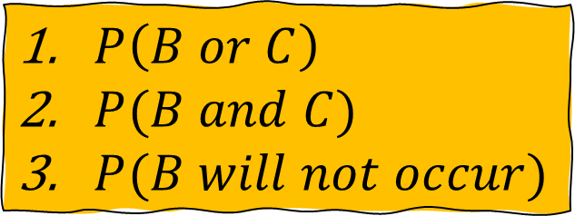
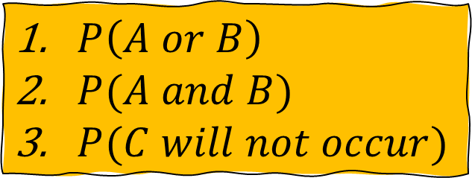

Self Practice
A = The sum of the two dice is 4
B = The sum of the two dice is at most 6
C = Doublet
For example, consider the experiment of throwing two dices. Write the sample space of this experiment.
 | 1 | 2 | 3 | 4 | 5 | 6
1 | 1,1 | 1,2 | 1,3 | 1,4 | 1,5 | 1,6
2 | 2,1 | 2,2 | 2,3 | 2,4 | 2,5 | 2,6
3 | 3,1 | 3,2 | 3,3 | 3,4 | 3,5 | 3,6
4 | 4,1 | 4,2 | 4,3 | 4,4 | 4,5 | 4,6
5 | 5,1 | 5,2 | 5,3 | 5,4 | 5,5 | 5,6
6 | 6,1 | 6,2 | 6,3 | 6,4 | 6,5 | 6,6
$P\left(A or B\right)$
$P(A and B)$
$P(C will not occur)$
$P\left(B or C\right)$
$P(B and C)$
$P(B will not occur)$
$P\left(A or C\right)$
$P(A and C)$
$P(A will not occur)$

Slide 31
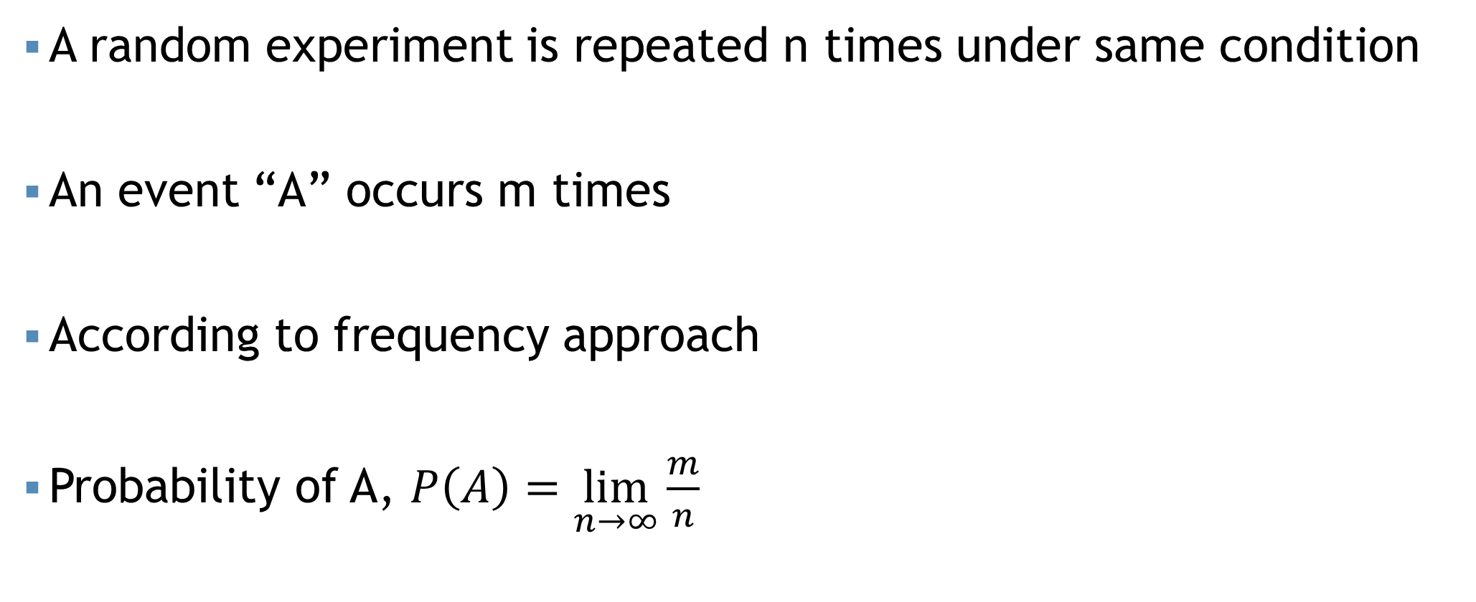
Frequency approach
A random experiment is repeated n times under same condition
An event “A” occurs m times
According to frequency approach
Probability of A, $P\left(A\right)=\lim_{n→∞}{\frac{m}{n}}$

Slide 32
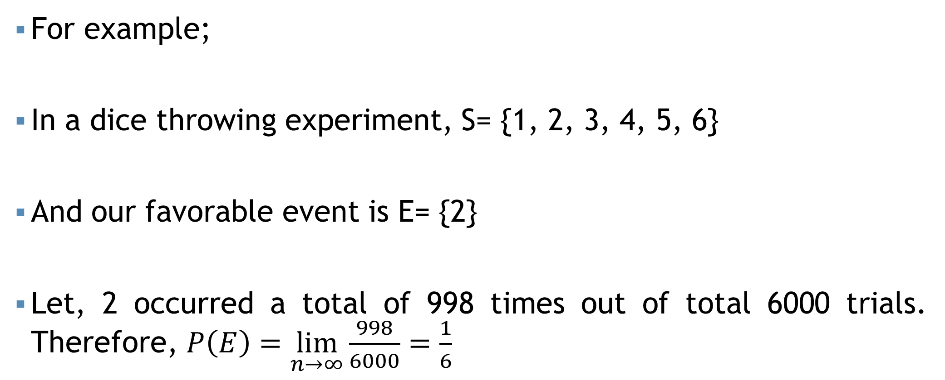
Frequency approach
For example;
In a dice throwing experiment, S= {1, 2, 3, 4, 5, 6}
And our favorable event is E= {2}
Let, 2 occurred a total of 998 times out of total 6000 trials. Therefore, $P\left(E\right)=\lim_{n→∞}{\frac{998}{6000}=\frac{1}{6}}$

Slide 33
Subjective approach
Based on the judgement (personal experience, prior information and belief etc.), one can assign probability to an event E of a random experiment.
For example; on a day of summer someone made a statement on probability that rain will occur on that day is .70, based on his previous experience.

Slide 34
Self Practice
In each of the following cases, indicate whether classical, empirical/frequency, or subjective probability is used.
A baseball player gets a hit in 30 out of 100 times at bat. The probability is .3 that he gets a hit in his next at bat.
A seven-member committee of students is formed to study environmental issues. What is the likelihood that any one of the seven is randomly chosen as the spokesperson?
You purchase a ticket for the Lotto Canada lottery. Over 5 million tickets were sold. What is the likelihood you will win the $1 million jackpot?
The probability of an earthquake in northern California in the next 10 years above 5.0 on the Richter Scale is .80.

Slide 35
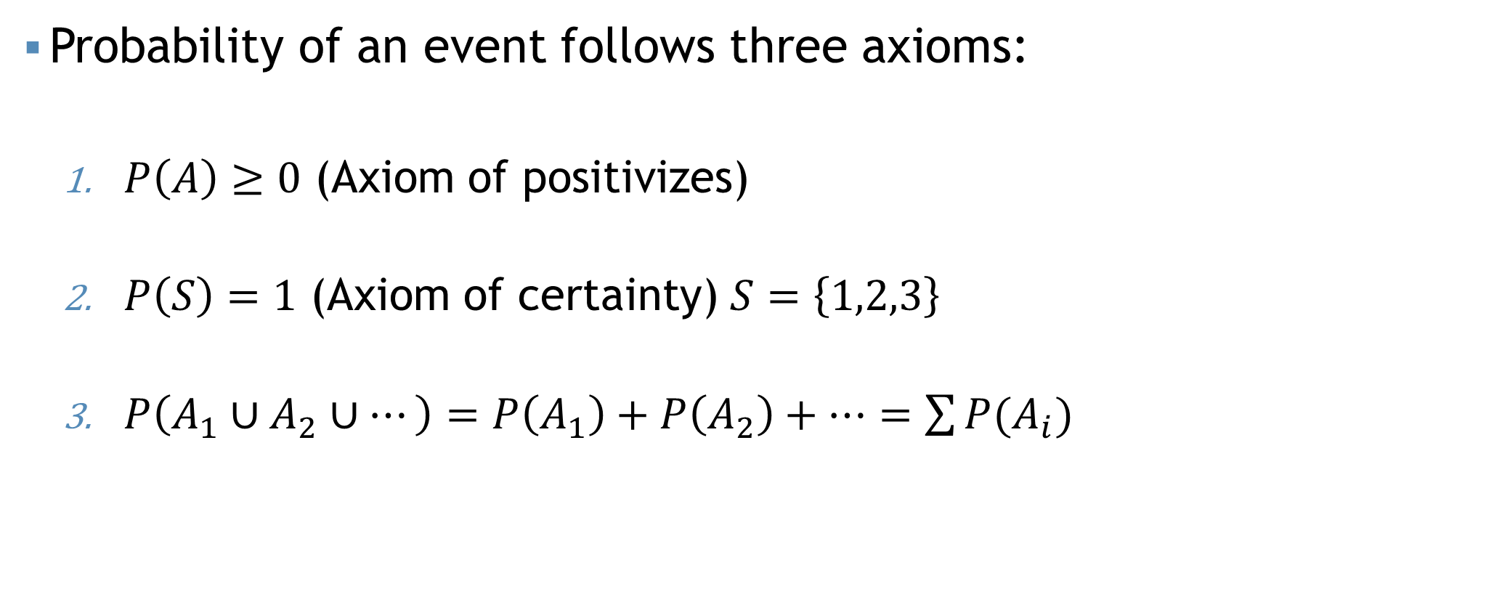
Axioms of probability
Probability of an event follows three axioms:
$P\left(A\right)≥0$ (Axiom of positivizes)
$P\left(S\right)=1$ (Axiom of certainty) $S=\left\{1,2,3\right\}$
$P\left(A_{1}∪A_{2}∪…\right)=P\left(A_{1}\right)+P\left(A_{2}\right)+…=\sum{P(A_{i})}$

Slide 36
More Practice…
Text book (Lind & Marchall): Page 140- Exercise: 1, 5, 7, 9 (Answers at the end of the books).
Helping hand 1 (Anderson, Sweeney & Williams): Page 162- Exercise: 14,15, 16, 18, 20 (Answers at the end of the books).

Slide 37
Probability Laws
Two basic rules/laws of probability theory-
Additive rule
Multiplicative rule
Disjoint, Joint events
Independent, Dependent events

Slide 38
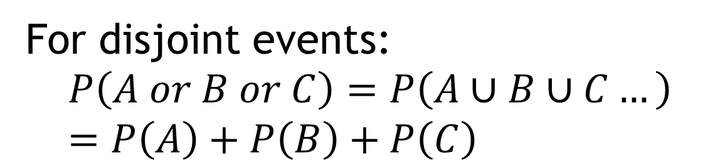
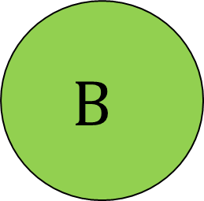
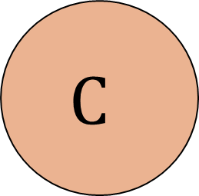

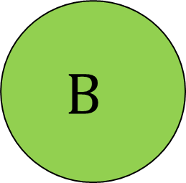

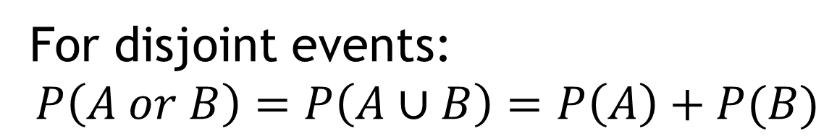
Additive rule
Exclusive/Disjoint events
For disjoint events:
$$P\left(A or B\right)=P\left(A∪B\right)=P\left(A\right)+P(B)$$
$$A$$
$$B$$
Exclusive/Disjoint events
For disjoint events:
$$P\left(A or B or C\right)=P\left(A∪B∪C…\right)=P\left(A\right)+P\left(B\right)+P\left(C\right)$$
$$A$$
$$B$$
$$C$$

Slide 39
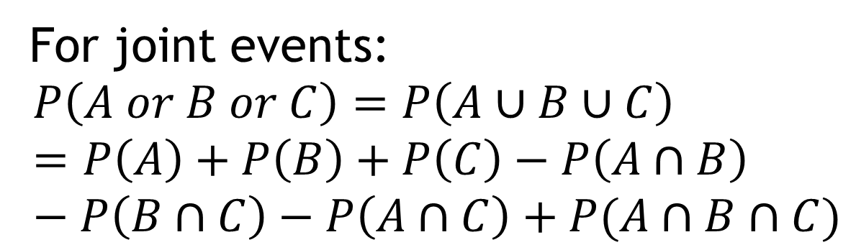





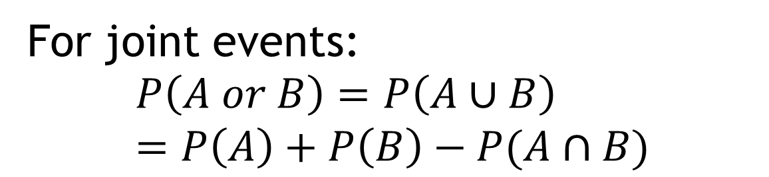
Additive rule
Joint events
For joint events:
$$P\left(A or B\right)=P\left(A∪B\right)=P\left(A\right)+P\left(B\right)−P(A∩B)$$
$$A$$
$$B$$
Joint events
For joint events:
$$P\left(A or B or C\right)=P\left(A∪B∪C\right)=P\left(A\right)+P\left(B\right)+P\left(C\right)−P\left(A∩B\right)−P\left(B∩C\right)−P\left(A∩C\right)+P(A∩B∩C)$$
$$A$$
$$B$$
$$C$$

Slide 40
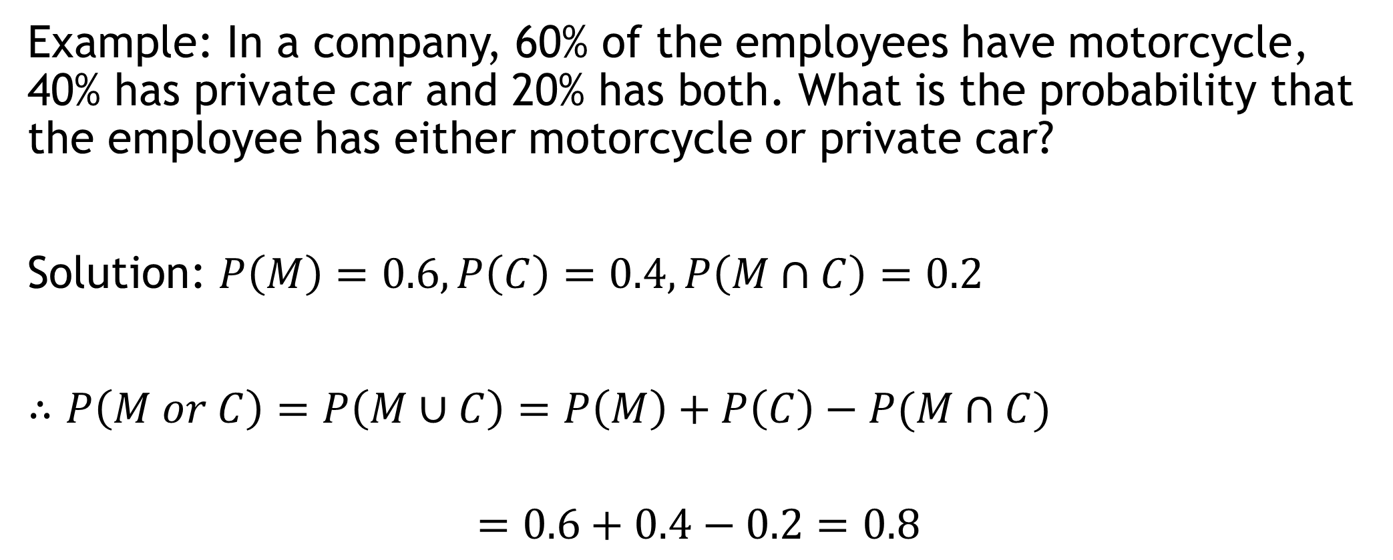
Additive rule
Example: In a company, 60% of the employees have motorcycle, 40% has private car and 20% has both. What is the probability that the employee has either motorcycle or private car?
Solution: $P\left(M\right)=0.6, P\left(C\right)=0.4, P\left(M∩C\right)=0.2$
$∴P\left(M or C\right)=P\left(M∪C\right)=P\left(M\right)+P\left(C\right)−P(M∩C)$
$$=0.6+0.4−0.2=0.8$$
80% employee has either motorcycle or private car

Slide 41
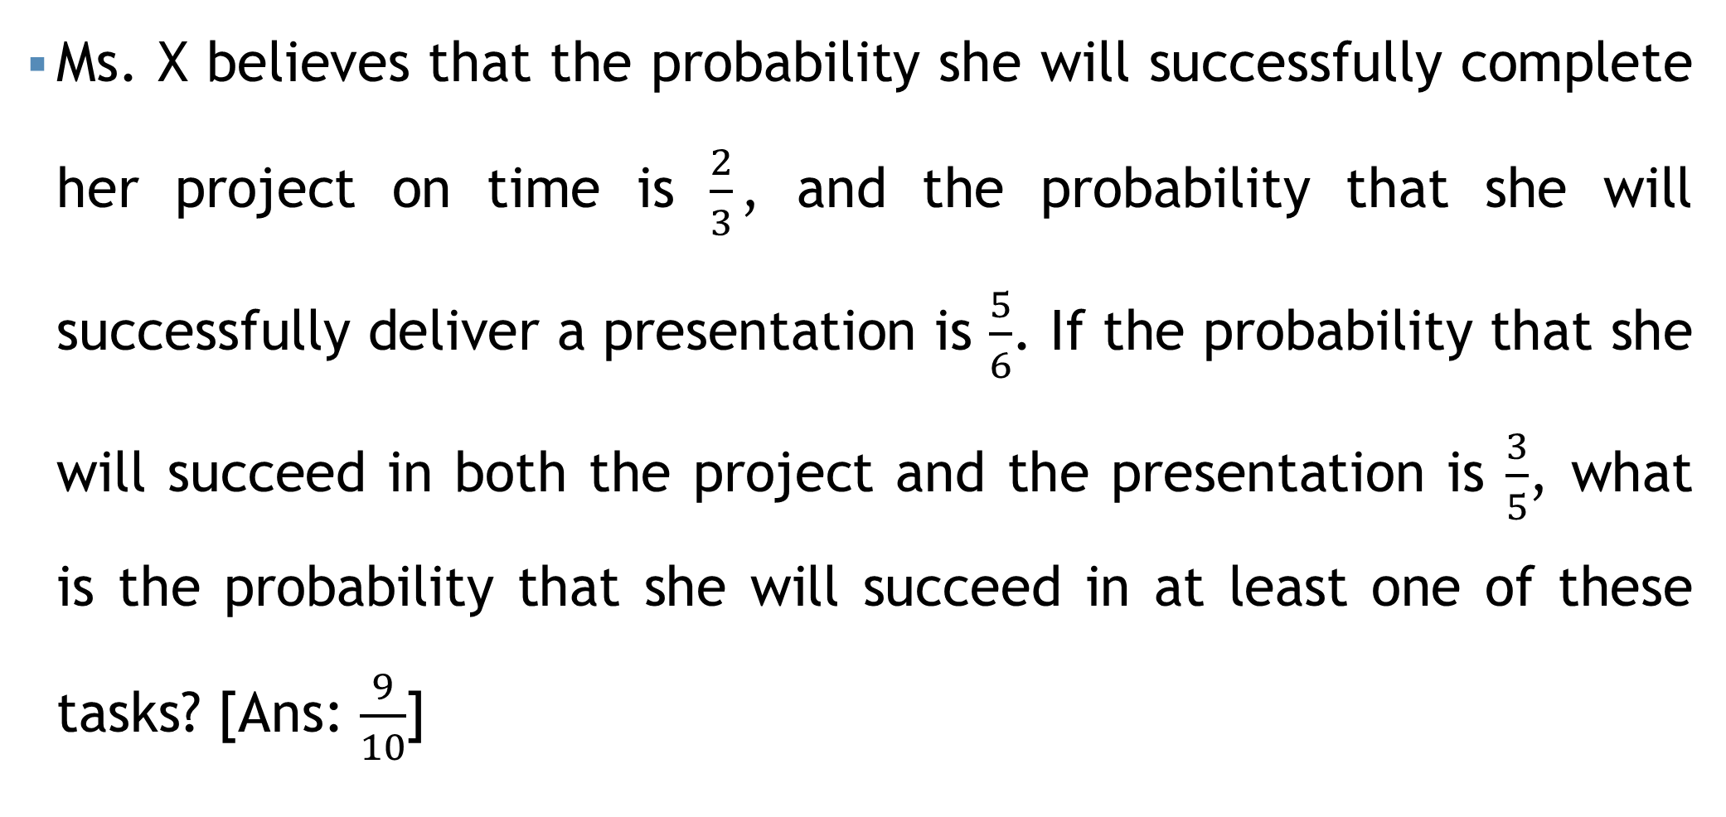
Additive rule
Ms. X believes that the probability she will successfully complete her project on time is $\frac{2}{3}$, and the probability that she will successfully deliver a presentation is $\frac{5}{6}$. If the probability that she will succeed in both the project and the presentation is $\frac{3}{5}$, what is the probability that she will succeed in at least one of these tasks? [Ans: $\frac{9}{10}$]

Slide 42
Additive rule
In a certain residential suburb, 60% of all households get Internet service from the local cable company, 80% get television service from that company, and 50% get both services from that company. If a household is randomly selected, what is the probability that it gets at least one of these two services from the company, and what is the probability that it gets exactly one of these services from the company? [Ans: 0.9, 0.4]

Slide 43



Additive rule
$$A$$
$$B$$
$$C$$
Consider a dartboard with a bullseye and two concentric rings around it. The probability of hitting the bullseye is 0.15, the probability of hitting the inner ring is 0.30, and the probability of hitting the outer ring is 0.40.
What is the probability that the projectile hits the target?
What is the probability that it misses the target?
Ans: 0.85
Ans: 1-0.85=???

Slide 44

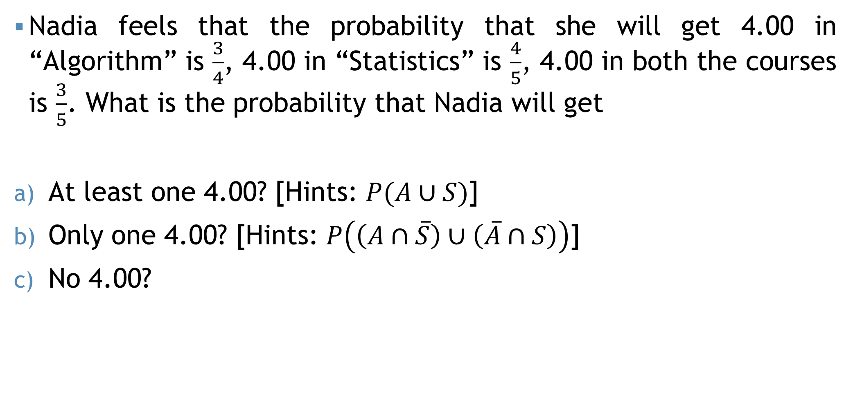

Self Practice
Nadia feels that the probability that she will get 4.00 in “Algorithm” is $\frac{3}{4}$, 4.00 in “Statistics” is $\frac{4}{5}$, 4.00 in both the courses is $\frac{3}{5}$. What is the probability that Nadia will get
At least one 4.00? [Hints: $P(A∪S)$]
Only one 4.00? [Hints: $P\left(\left(A∩\overline{S}\right)∪\left(\overline{A}∩S\right)\right)$]
No 4.00?
$$A$$
$$S$$

Slide 45



Self Practice
A sample survey was undertaken to investigate which papers A, B, and C people read. In survey of 100 people following results were obtained: 60 people read A, 40 people read B, 70 people read C, 32 people read A and B, 45 people read A and C, 38 people read B and C, 30 people read A, B, C. If a person is selected at random, find the probability,
Read only newspaper A.
Read only one news paper.
Read at least one news paper.
Read at most one news paper.
Ans: 0.13
$$A$$
$$B$$
Ans: 0.3
$$C$$
Ans: 0.85
Ans: 0.45

Slide 46
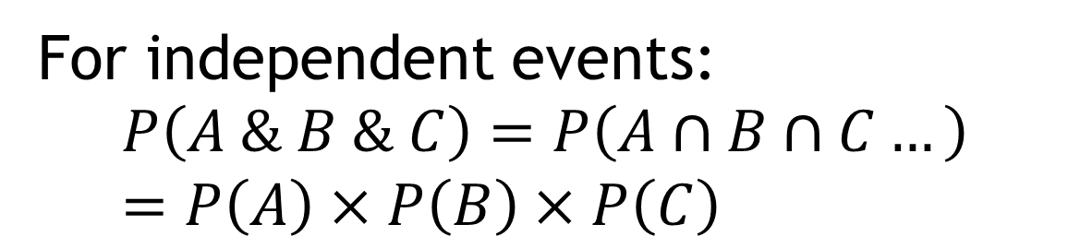
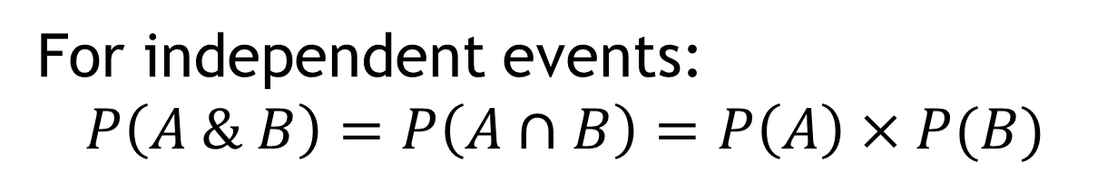
Multiplicative rule
Independent events
For independent events:
$$P\left(A \& B\right)=P\left(A∩B\right)=P\left(A\right)×P(B)$$
$$A$$
$$B$$
Independent events
For independent events:
$$P\left(A \& B \& C\right)=P\left(A∩B∩C…\right)=P\left(A\right)×P\left(B\right)×P\left(C\right)$$
$$A$$
$$B$$
$$C$$

Slide 47
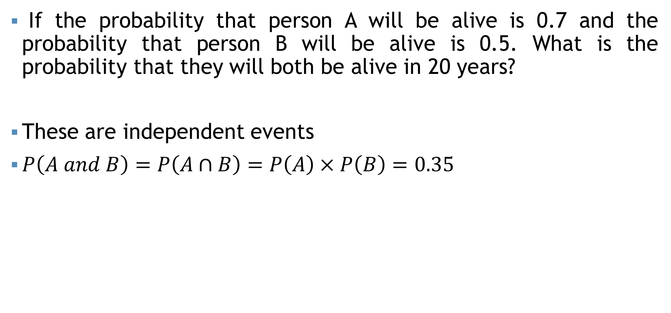
Multiplicative rule
If the probability that person A will be alive is 0.7 and the probability that person B will be alive is 0.5. What is the probability that they will both be alive in 20 years?
These are independent events
$P\left(A and B\right)=P\left(A∩B\right)=P\left(A\right)×P\left(B\right)=0.35$

Slide 48
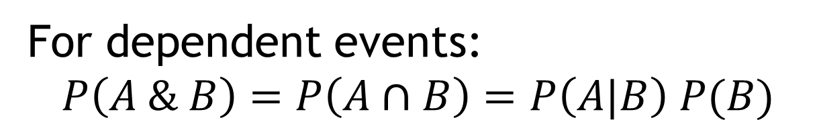
Multiplicative rule
For dependent events:
$$P\left(A \& B\right)=P\left(A∩B\right)=P\left(A|B\right) P(B)$$
Conditional probability
Probability of A “given that” B

Slide 49
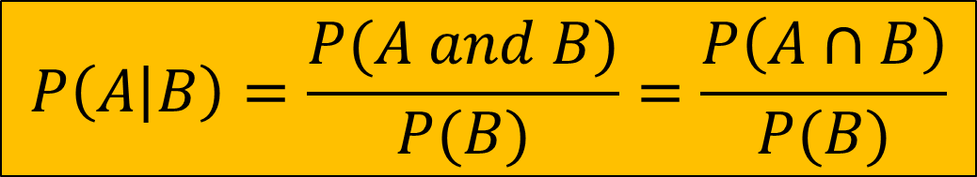
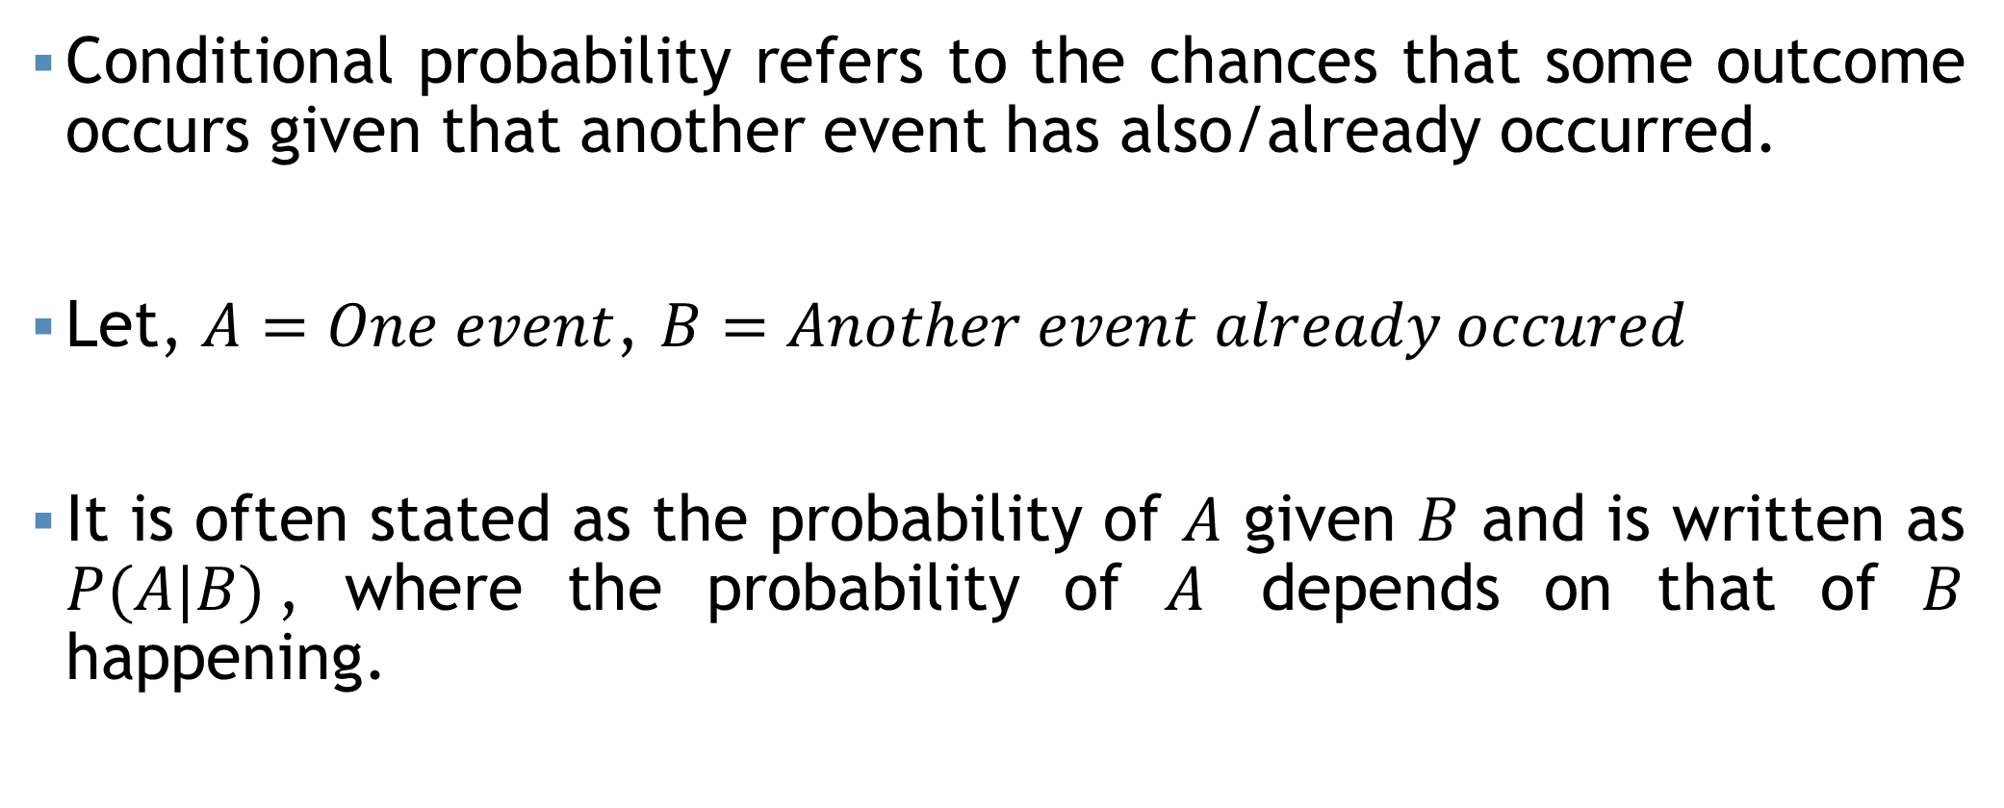
Conditional Probability
Conditional probability refers to the chances that some outcome occurs given that another event has also/already occurred.
Let, $A=One event$, $B=Another event already occured$
It is often stated as the probability of $A$ given $B$ and is written as $P(A|B)$, where the probability of $A$ depends on that of $B$ happening.
$$P\left(A | B\right)=\frac{P(A and B)}{P(B)}=\frac{P\left(A∩B\right)}{P(B)}$$

Slide 50
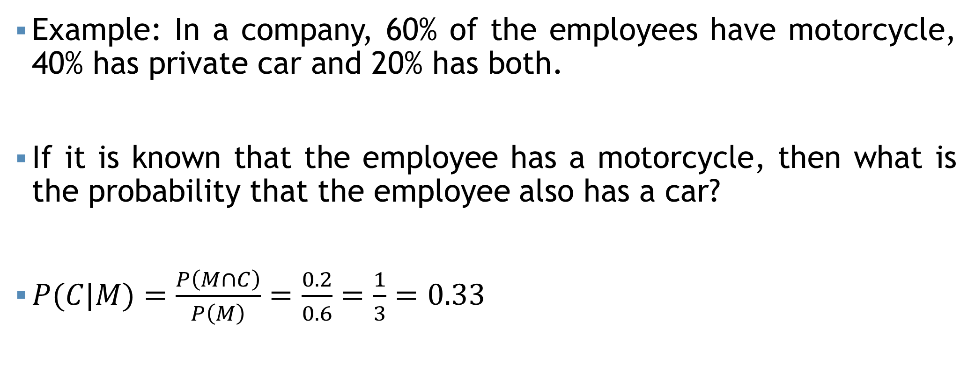
Conditional Probability
Example: In a company, 60% of the employees have motorcycle, 40% has private car and 20% has both.
If it is known that the employee has a motorcycle, then what is the probability that the employee also has a car?
$P(C|M)=\frac{P\left(M∩C\right)}{P\left(M\right)}=\frac{0.2}{0.6}=\frac{1}{3}=0.33$

Slide 51
Conditional Probability
Suppose a balanced die is rolled once.
Find the probability that a number divisible by 3 is rolled given that the die comes up even.
Find the probability that the die comes up even given that a number divisible by 3 is rolled.
Find the probability that a number divisible by 3 is rolled given that die comes up at most 4.
Find the probability that the die comes up at most 4 given that a number divisible by 3 is rolled.

Slide 52
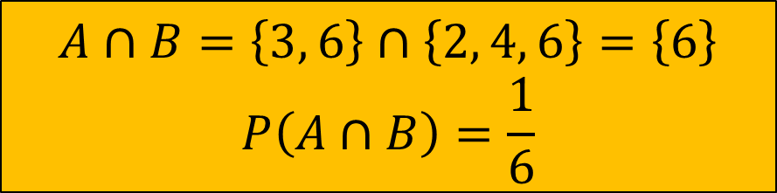


Conditional Probability
Sample space for rolling a die once, $S=\left\{1, 2, 3, 4, 5, 6\right\}$
a) Let,
$A=Number divisible by 3=\left\{3, 6\right\}$
$B=Even number=\left\{2, 4, 6\right\}$
$P\left(A | B\right)=\frac{P(A∩B)}{P(B)}$
$∴P\left(A | B\right)=\frac{\frac{1}{6}}{\frac{1}{2}}=0.33$
Probability that a number divisible by 3 is rolled given that the die comes up even.
$$A∩B=\left\{3, 6\right\}∩\left\{2, 4, 6\right\}=\left\{6\right\}$$
$$P\left(A∩B\right)=\frac{1}{6}$$
$$B=\left\{2, 4, 6\right\}$$
$$P\left(B\right)=\frac{3}{6}=\frac{1}{2}$$

Slide 53

Conditional Probability
b) $\left(Ans:0.5\right)$
c) $\left(Ans:0.25\right)$
d) $\left(Ans:0.5\right)$

Slide 54


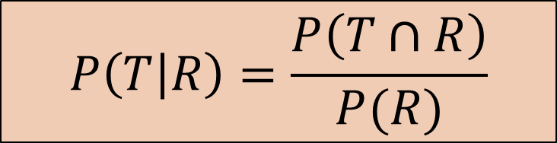




Conditional Probability
In rainy season, it rains 70% of the days in Bangladesh. When it rains, 80% times it makes thunderstorms. What is the probability that, in a particular day of rainy season, it will rain and it will thunderstorm?
$R$ be an event of rain
$T$ be an event of Thunderstorms
$$P\left(R and T\right)=P(R∩T)$$
$P\left(R\right)=70\%=0.7$
$$P\left(T | R\right)=80\%=0.8$$
$$P\left(T | R\right)=\frac{P\left(T∩R\right)}{P(R)}$$
$$P\left(T∩R\right)=P\left(T | R\right)×P\left(R\right)$$
$$P\left(T∩R\right)=0.8×0.7=0.56$$

Slide 55
Self Practice
In a certain coastal city, during the hurricane season, it is known that hurricanes occur on 60% of the days. When a hurricane occurs, there is an 85% chance that it will also lead to heavy rainfall.
Calculate the probability that on a given day during the hurricane season, both a hurricane and heavy rainfall will occur.
Determine the probability that heavy rainfall will occur given that a hurricane has occurred on a particular day.

Slide 56
Self Practice
Mr. Fahad and Mr. Khan has to tour abroad for their business frequently. Mr. Fahad tours 65% of the times in a year at abroad and Mr. Khan tours 50% of the times in a year at abroad. What is the probability that, on January 01, 2016, both Mr. Fahad and Mr. Khan will be at abroad?

Slide 57
Contingency table
A contingency table, also known as a cross-tabulation or crosstab, is a statistical table used to analyze and display the relationship between two categorical variables.
For example, The question, "Do you like watching TV?" was asked of 100 people. Results are shown in the table.
 | Yes | No | Total
Male | 19 | 41 | 60
Female | 12 | 28 | 40
Total | 31 | 69 | 100

Slide 58
Joint Probability
Both event occur together
For example, The question, "Do you like watching TV?" was asked of 100 people. What is the probability of a randomly selected individual being a male who likes watching TV?
 | Yes | No | Total
Male | 19 | 41 | 60
Female | 12 | 28 | 40
Total | 31 | 69 | 100

Slide 59
Joint Probability
Both event occur together
For example, The question, "Do you like watching TV?" was asked of 100 people. What is the probability of a randomly selected individual being a male who likes watching TV?
 | Yes | No | Total
Male | 19 | 41 | 60
Female | 12 | 28 | 40
Total | 31 | 69 | 100

Slide 60
Marginal Probability
Single event occurring independently of any other events.
For example, The question, "Do you like watching TV?" was asked of 100 people. What is the probability of a randomly selected individual like watching TV?
 | Yes | No | Total
Male | 19 | 41 | 60
Female | 12 | 28 | 40
Total | 31 | 69 | 100

Slide 61
Marginal Probability
Single event occurring independently of any other events.
For example, The question, "Do you like watching TV?" was asked of 100 people. What is the probability of a randomly selected individual like watching TV?
 | Yes | No | Total
Male | 19 | 41 | 60
Female | 12 | 28 | 40
Total | 31 | 69 | 100

Slide 62
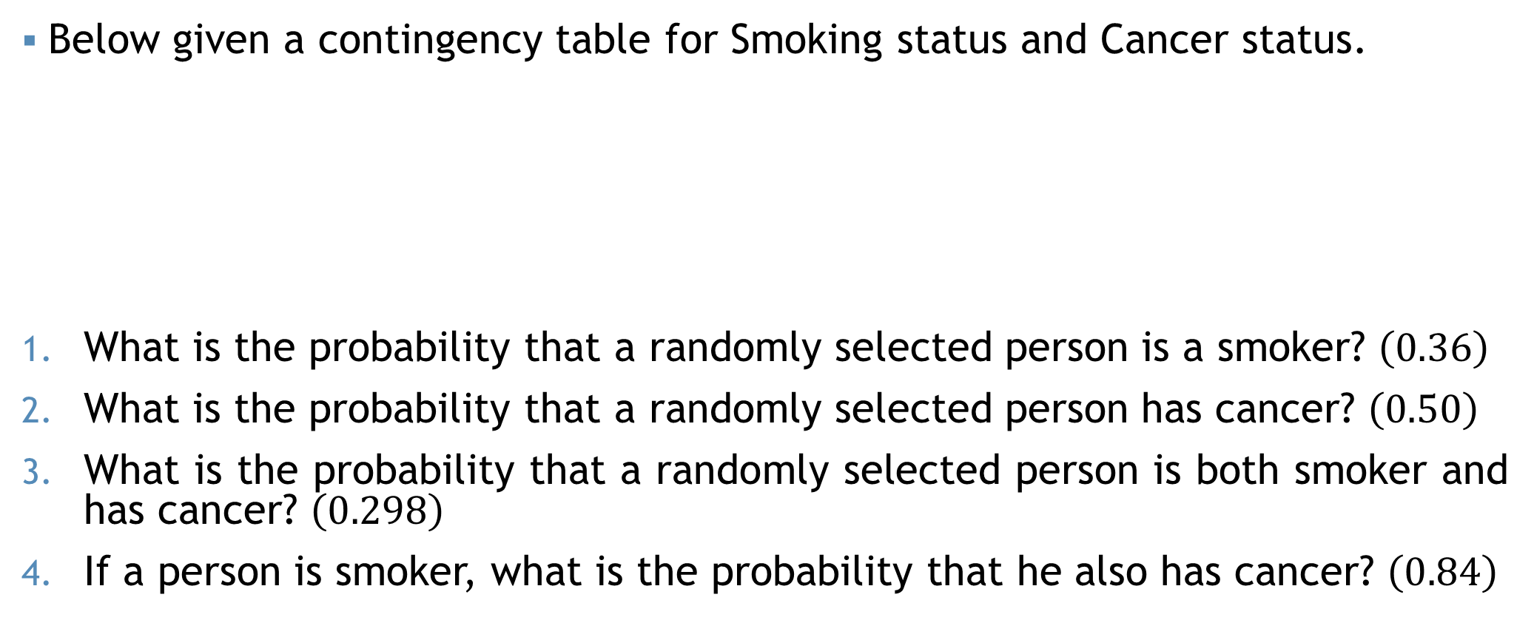
Example
Below given a contingency table for Smoking status and Cancer status.
What is the probability that a randomly selected person is a smoker? $\left(0.36\right)$
What is the probability that a randomly selected person has cancer? $\left(0.50\right)$
What is the probability that a randomly selected person is both smoker and has cancer? $\left(0.298\right)$
If a person is smoker, what is the probability that he also has cancer? $\left(0.84\right)$
 | Cancer | Healthy | Total
Smoker | 7860 | 1530 | 9390
Non smoker | 5390 | 11580 | 16970
Total | 13250 | 13110 | 26360

Slide 63
With and Without Replacement

Slide 64
With and Without Replacement

Slide 65
With and Without Replacement

Slide 66
With and Without Replacement

Slide 67
With and Without Replacement
If the elements of a sample are drawn randomly one by one and after each draw the element is returned to the population = With Replacement
With Replacement

Slide 68
With and Without Replacement

Slide 69
With and Without Replacement

Slide 70
With and Without Replacement
If the elements of a sample are drawn randomly one by one and after each draw the element is not returned to the population = With Out Replacement
Without Replacement

Slide 71
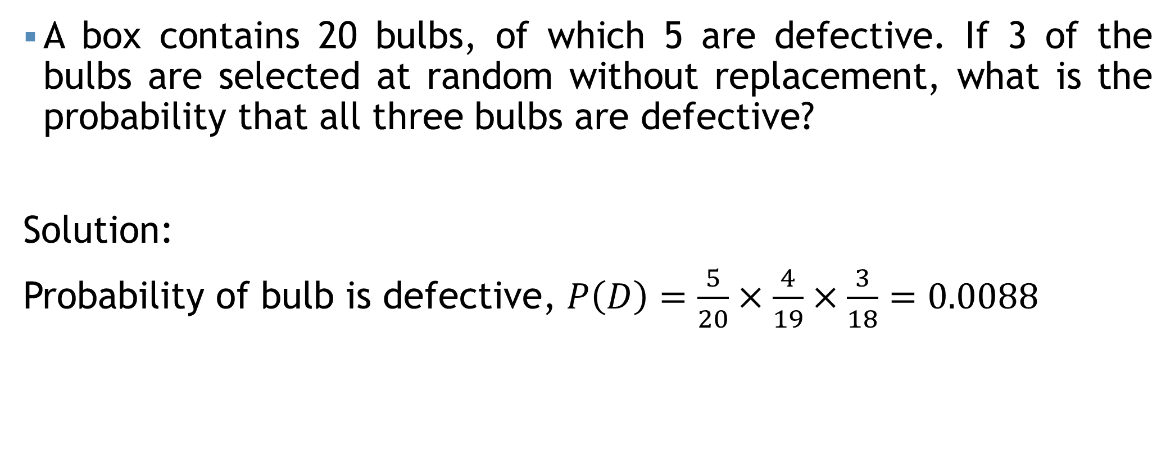
With and Without Replacement
A box contains 20 bulbs, of which 5 are defective. If 3 of the bulbs are selected at random without replacement, what is the probability that all three bulbs are defective?
Solution:
Probability of bulb is defective, $P\left(D\right)=\frac{5}{20}×\frac{4}{19}×\frac{3}{18}=0.0088$

Slide 72
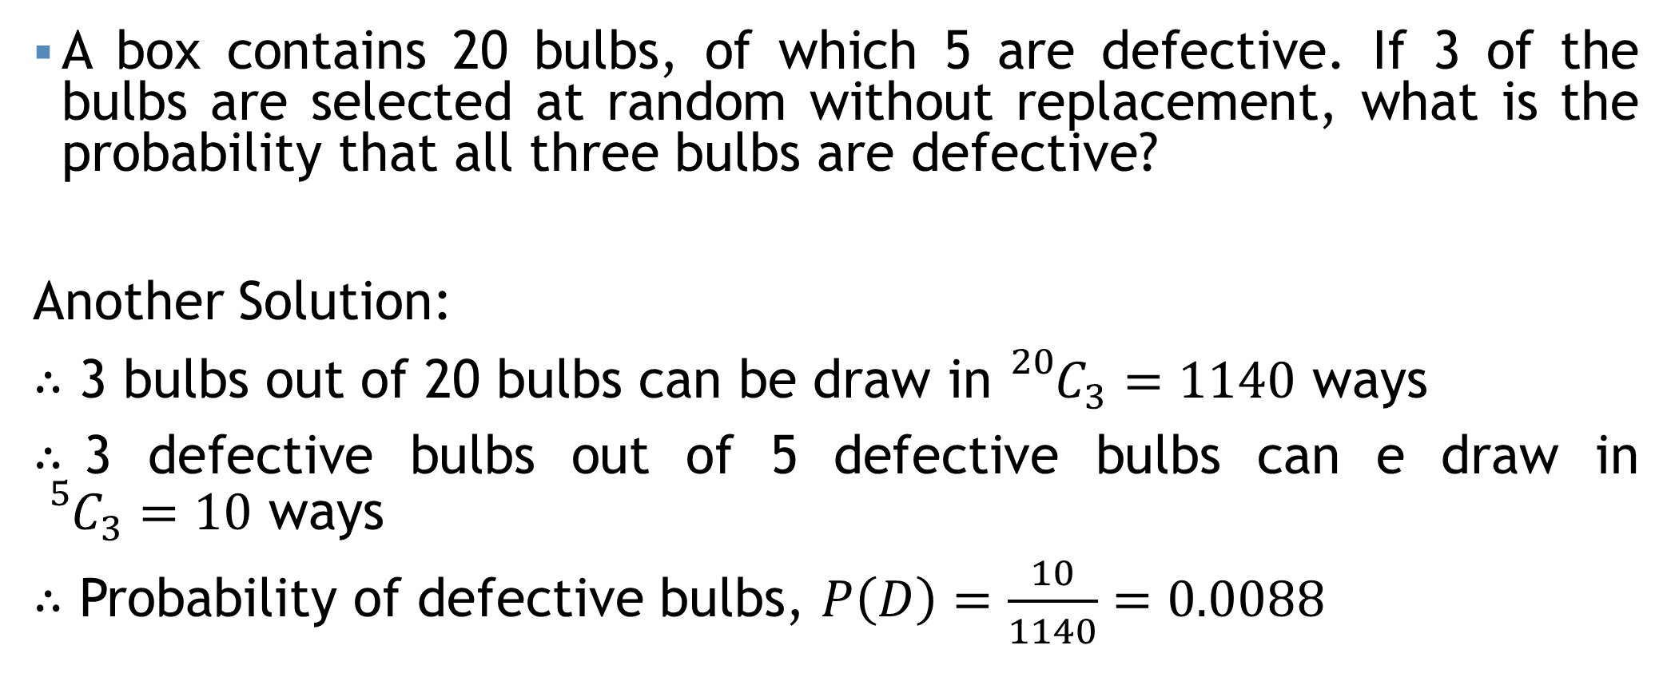
With and Without Replacement
A box contains 20 bulbs, of which 5 are defective. If 3 of the bulbs are selected at random without replacement, what is the probability that all three bulbs are defective?
Another Solution:
$∴$ 3 bulbs out of 20 bulbs can be draw in ${}_{}^{20}{C_{3}=1140}$ ways
$∴$3 defective bulbs out of 5 defective bulbs can e draw in ${}_{}^{5}{C_{3}=10}$ ways
$∴$ Probability of defective bulbs, $P\left(D\right)=\frac{10}{1140}=0.0088$

Slide 73
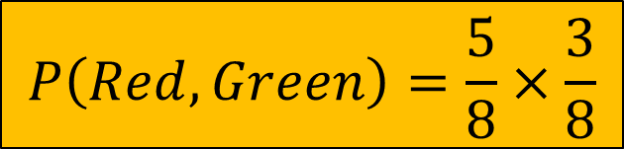
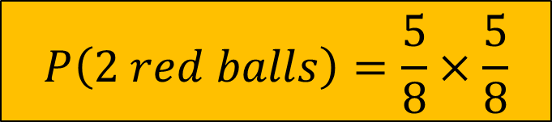


Practice sheet
$$P\left(2 red balls\right)=\frac{5}{8}×\frac{5}{8}$$
A bag contains 5 red balls and 3 green balls. You are asked to draw 2 balls from the bag one after another, with replacement (meaning after drawing a ball, you put it back in the bag).
What is the probability of drawing two red balls consecutively?
What is the probability of drawing one red ball and one green ball in two draws, in any order?
$$P\left(Red, Green\right)=\frac{5}{8}×\frac{3}{8}$$
$$\frac{15}{64}+\frac{15}{64}=\frac{15}{32}$$
$$P\left(Green, Red\right)=\frac{3}{8}×\frac{5}{8}$$

Slide 74


Some Notations
For two events (A, B):
$P\left(Only A\right)=P\left(A∩B^{′}\right)=P\left(A\right)−P\left(A∩B\right)$
$P\left(Only B\right)=P\left(A^{′}∩B\right)=P\left(B\right)−P(A∩B)$
$P\left(Neither A nor B\right)=P\left(A^{′}∩B^{′}\right)=1−P\left(A∪B\right)$
$P\left(Exactly one\right)=P\left(Only A\right)+P\left(Only B\right)$
$P\left(At most one\right)=1−P(A∩B)$
For Three events (A, B, C):
$P\left(Only A\right)=P\left(A∩B^{′}∩C′\right)=P\left(A\right)−P\left(A∩B\right)−P\left(A∩C\right)+P(A∩B∩C)$
$P\left(Only B\right)=P\left(A^{′}∩B∩C′\right)$; $P\left(Only C\right)=P(A^{′}∩B^{′}∩C)$
$P\left(None of events\right)=P\left(A^{′}∩B^{′}∩C′\right)$
$P\left(Exactly one\right)=P\left(Only A\right)+P\left(Only B\right)+P(Only C)$
$P\left(At most one\right)=1−P(A∩B∩C)$
$P\left(Only A and B \left(not C\right)\right)=P\left(A∩B∩C^{′}\right)=P(A∩B)−P(A∩B∩C)$
$P\left(Only A and C \left(not B\right)\right)=P(A∩C∩B^{′})$; $P\left(Only B and C \left(not A\right)\right)=???$

Slide 75
Mathematical exercise
To access additional mathematical problems, please refer to the PDF lecture notes.

Slide 76
Thank You

